Slide 1
WEGMANS ITEM-X PROJECT
02 . 26 . 2018
Team 1: Xiangyu Lin | Hongyi Zhu | Xuan Li | Yecheng Zhai | Linwei Zeng

Slide 2



OUTLINE
Summary, Conclusion & Managerial Recommendation
Attribute “M” Analysis
“Size of Prize” Calculation

Slide 3
SUMMARY & CONCLUSION
Managerial Recommendation
Attribute “M” Analysis
Attribute “M” is NOT the major barrier for customers to buy Item-X; attribute “C” is.
66% of those who have a concern will never purchase.
26% customers will be persuaded by using a marketing message.
“Size of prize”
If we can raise awareness of its existence, 51% of customers will be expected to try the Item-X.
Item-X’ s “Size of Prize” would be 37,485 units/week.
Raise customer awareness of the existence of Item-X through marketing methods, to attracted 51% more customers to try Item-X.
Send out marketing message of attribute “M” when conducting marketing campaign, to persuade 26% customers who have concern on attribute “M”.
Improve or change attribute “C” for Item-X, since it is the major barrier for customers to buy Item-X, with 18% customers have concern on it.

Slide 4
ATTRIBUTE “M” ≠ MAJOR BARRIER
% of respondents who have concerns
Attribute
7% Consumers in the sample has a concern with “M”.
18% customers have concern with “C”.
For those respondents who didn’t purchase Item-X, attribute “C” is their major concern!

Slide 5
ATTRIBUTE “M” ≠ MAJOR BARRIER
 | More | No Change | Less | No Response | Total | Calculation
Respondents | 100 | 252 | 25 | 251 | 628
Respondents who didn’t buy | 1 | 226 | 24 | 251* (226+24)/(628-251) =166.4 |  | Never purchase rate = （226+24+166.4)/628 = 66%
Respondents who are persuaded and bought | 99 | 26 | 1 | 251* 99/(628-251) =65.9 |  | Persuasion rate = (99+65.9)/628 = 26%
*We only use data from households who exist in both survey data and insider data
*No response = didn’t receive message in survey
Conclusion:
66% of those who have a concern will never purchase.
26% customers will be persuaded by using a marketing message.

Slide 6

50.87% CUSTOMERS WILL TRY ITEM-X WHEN AWARE
For ‘Survey data’ alone, we consider E3+E5 are people who will buy item-X buy raising awareness.
Result by using survey data only:
(E3+E5)/(E3+E4+E5+E6)
=56.4%
After checking insider transaction data, we predict number of people who will buy X by selecting people who bought T0 before and fall in endpoints of E3, E4, E5 and E6.
Result by using insider transaction data only:
415/829=50.06%*
After checking insider transaction data and survey data, we reweight the result.
Result by reweighting data between survey and insider transaction data:
415/829*1.016=50.87%
Survey Data Insiders Weight
E3+E4+E5+E6 | 0.63 | 0.62 | ×1.016
*Note: There are 829 people who have an endpoints of E3, E4, E5 or E6 and Alternative is ‘’T0’ appearing in the transaction data. Among these people, 414 have bought T0 before and 415 haven’t.

Slide 7
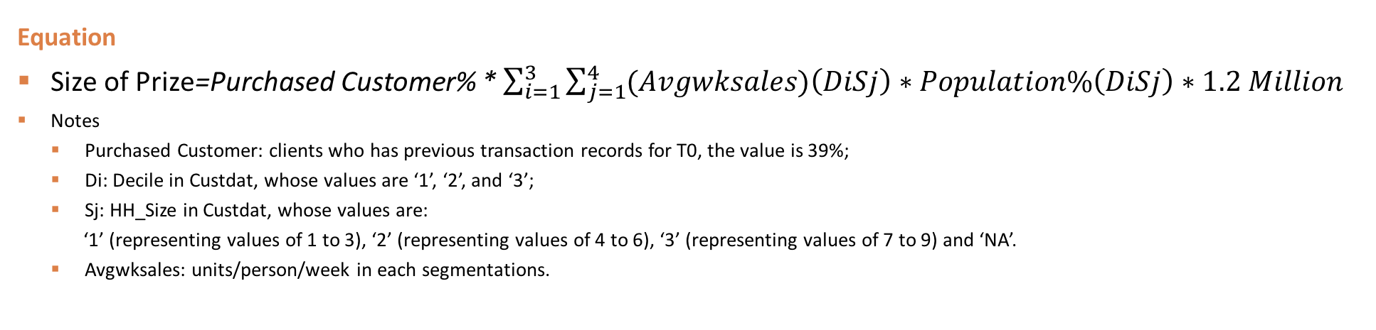
CALCULATION FLOWCHART FOR SIZE OF PRIZE
Calculate size of prize by total # of customer * AVG(units/person/week)
Merge demographic info and set 12 segmentations according to Decile & Size
Calculate units/person/week of 12 segmentations (adding Endpoint together)
Classify 3 groups according to Endpoint (E1&E3, E5, E2&E4&E6) inside each segmentations
Calculate predict size of Custdata by multiplying average units and population in each segmentations
Validate predict accuracy by calculating actual sales of Custdata (From insider and Top30 transactions)
Calculate Total Size of Prize
Equation
Size of Prize=Purchased Customer% * $\sum_{i=1}^{3}{\sum_{j=1}^{4}{(Avgwksales)\left(DiSj\right)∗Population\%\left(DiSj\right)∗1.2 Million}}$
Notes
Purchased Customer: clients who has previous transaction records for T0, the value is 39%;
Di: Decile in Custdat, whose values are ‘1’, ‘2’, and ‘3’;
Sj: HH_Size in Custdat, whose values are:
‘1’ (representing values of 1 to 3), ‘2’ (representing values of 4 to 6), ‘3’ (representing values of 7 to 9) and ‘NA’.
Avgwksales: units/person/week in each segmentations.

Slide 8
ASSUMPTIONS & LIMITATION
Assumption:
In population, for each segment, endpoint percentage equals to sample segments’ endpoint percentage
People’s behaviors and attitudes are consistent
Only decile and family size determine customers’ Item – X consumption.
The percentage of non-purchasers will be the same for the survey group and the population
E1
E3
E5
E2
E4
E6
Purchase
No change/Less comfortable: not purchase
More comfortable: purchase
No respond: based on above projection
Limitation:
We neglect other demographic characteristics’ influence
The endpoint distribution and non-purchasers’ percentage in actual population might be different from survey sample
Peoples’ behaviors and attitudes might be different
E.g. Endpoint E3/E4/E5/E6 ->past Item-X consumption record
Follow-up questions’ non-respondents’ attitudes are ambiguous
Accuracy↓

Slide 9
DATA PREPARATION
DF1:
Aggregated units, post questionnaire units in insider data by HH & Alternative
Merge the aggregation results above with the survey data and loyalty card data (1 + 2 + 4)
DF2:
Aggregated units, post questionnaire units in Top30 data by HH & Alternative
Merge the aggregation results above with the loyalty card data (3+ 4)
Survey Data (1)
HH | ENDPOINT | M | FOLLOWUP
Insider Transaction Data (2)
HH | ALTERNATIVE | UNITS | UNITS_POST
Top30 Data (3)
HH | ALTERNATIVE | UNITS | UNITS_POST
Loyalty Card Data (4)
HH | DECILE | SIZE 1 – 3 Small (1) 4 – 6 Medium (2) 7 – 9 Large (3) NA (NA)

Slide 10
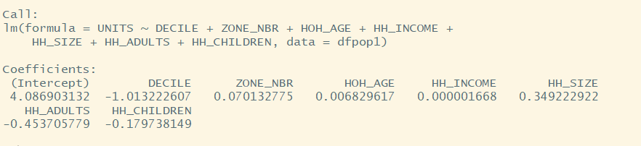
SEGMENTATION METHOD & KEYS
Keys in Demographic Information
Decile: Spend decile of the household compared to the total customer (1 > 2 > 3)
Size: Number of people in household
12 demographic segmentation in total
# of Household | Family Size
1 – 3 | Small (1)
4 – 6 | Medium (2)
7 – 9 | Large (3)
NA | NA
Segmentation within each Demographic Segmentation
Endpoint | Calculation
E1 & E3 (will buy) | (Purchasing Data for E1: UNITS+UNITS_POST; E3: UNITS_POST)
E5 (will buy after raising awareness) | (Purchasing Data for E5: UNITS_POST)
E2 & E4 & E6 (more comfortable will buy) | (Purchasing Data for E2&E4&E6: UNITS_POST) *Conditions: M=N-, FOLLOWUP=‘MORE’ & ‘MORE’ in ‘NA’

Slide 11
“SIZE OF PRIZE” CALCULATION
Item-X’ s Size of Prize would be 37,485 units/week
Decile & Size | Sum of E1-E6 Units/wk/person (Avgwksales) | Population of Segmentations of Custdat | % of Segmentations’ population
D1S1 | 0.0943 | 4328 | 23%
D1S2 | 0.0935 | 3316 | 18%
D1S3 | 0.0844 | 394 | 2%
D2S1 | 0.0782 | 3661 | 19%
D2S2 | 0.0680 | 1890 | 10%
D2S3 | 0.0309 | 182 | 1%
D3S1 | 0.0537 | 2783 | 15%
D3S2 | 0.0613 | 1413 | 7%
D3S3 | 0.0318 | 127 | 1%
D1NA | 0.1441 | 173 | 1%
D2NA | 0.1276 | 259 | 1%
D3NA | 0.0956 | 324 | 2%
Predict Size of Prize of Custdat:
sum(Units/wk/person * segmentations’ population * 39%)
=588.8 units/week
Actual size:
Total Units/wk of insider + Total Units/wk of other top 30
=530 units/week
The prediction‘s error is acceptable(+9.9%)
Total Size of Prize for Households:
Sum(Units/wk/person * % segmentations’ population * 1.2M*39%)
=37485 units/ week

Slide 12
Q & A
02 . 26 . 2018
Team 1: Xiangyu Lin | Hongyi Zhu | Xuan Li | Yecheng Zhai | Linwei Zeng

